Slide 1
Convolutional Neural Networks

Slide 2
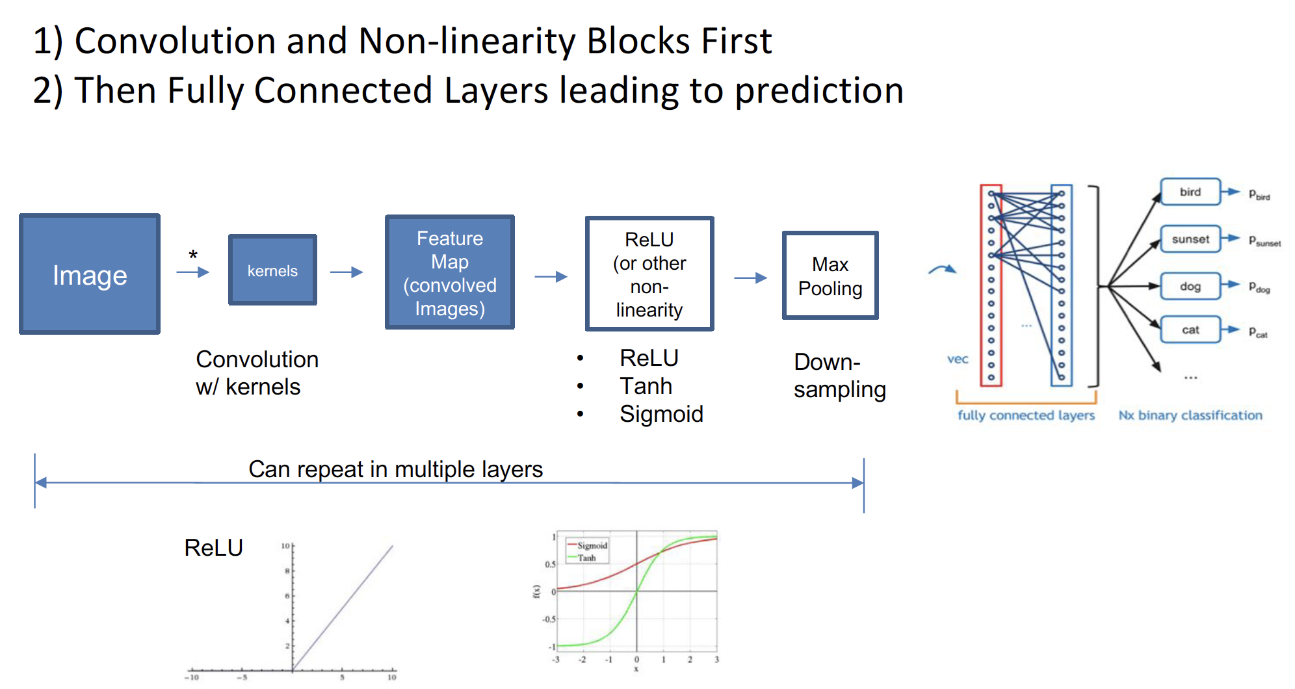
Notes:
Pooling downsamples size of our activation maps
Take our last conv output then use a fully connected layer connected to all of these conv outputs and use that to get a final score func

Slide 3
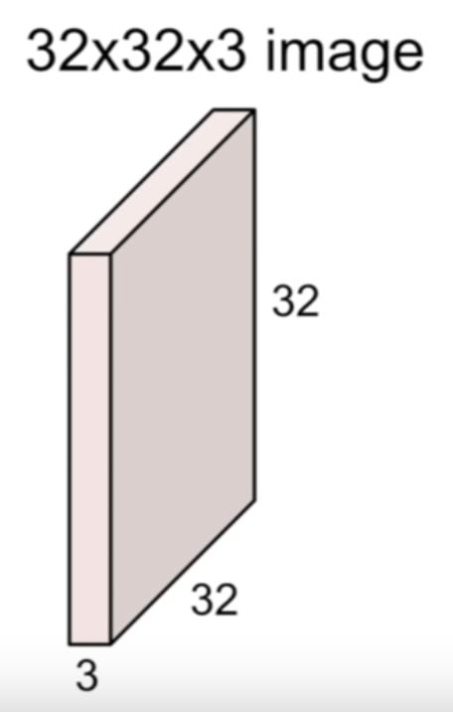
Convolution Layer
Instead of stretching the image into one long vector we are now going to keep the structure of the three dimensional input.
Notes:
Main difference between convolution layer and fully connected layer is that we are trying to preserve spatial structure

Slide 4
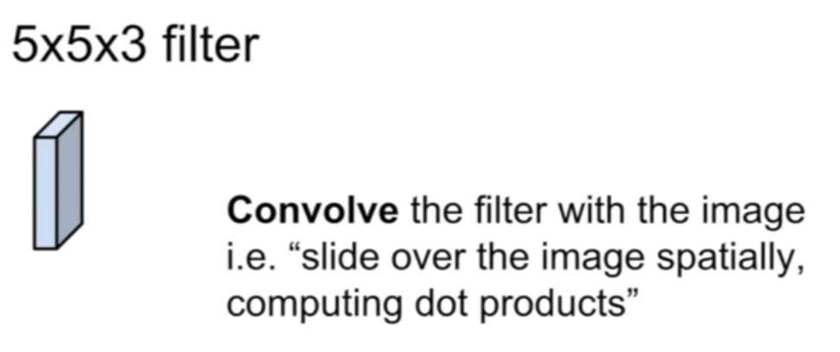
Convolution Layer
Notes:
Our weights are going to be these small filters in this case a 5 x 5 x3 filter
Filter = kernel =receptive field
We are going to take this filter and slide it over the image spatially and compute dot products at every spatial location

Slide 5
Convolution Layer
Filters always extend the full depth of the input volume
Notes:
The filters are just a smaller spatial area in this case 5 by instead of the full 32 by 32 but they are always going to go through the full depth

Slide 6
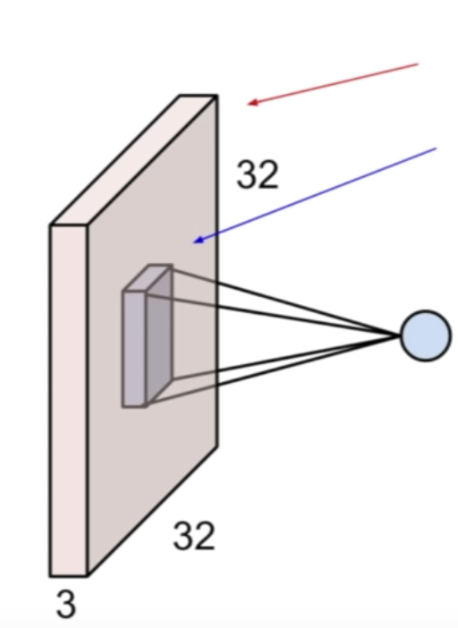
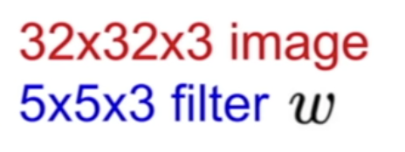
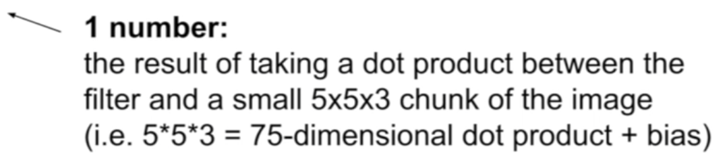
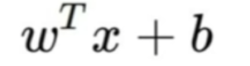
Convolution Layer
Notes:
Then we are going to take this filter and at a given spatial location we are going to do a dot product between the filter and a chunk of the image.
We are going to overlay filter on top of a spatial location in the image and then the dot product.
The multiplication of each element of that filter with each corresponding element in that spatial location that it is on top of.
Since our filter is 5x5x3 that is the number of multiplications we are going to do plus the bias term
W needs to be transposed so dot product works out! Take transpose to get a row out of w
You can think of this as element wise multiplication but it same as stretching out filter and input layer and taking the dot product after
We would stretch out 5 by 5 by 3 a get (1 x 75 ) and multiply that with image of ( 75 by 1 )
In essence we are plopping the filter on top of the imagine and multiplying all the corresponding values together

Slide 7
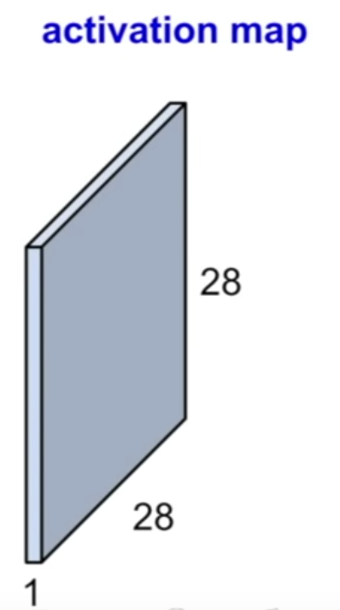
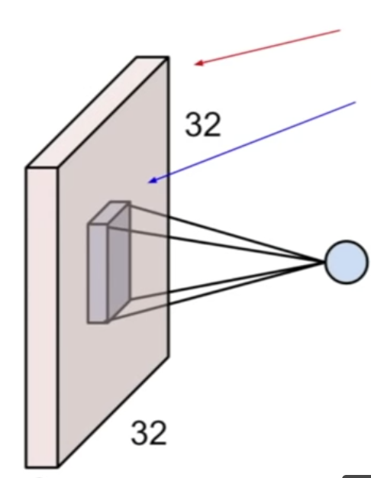
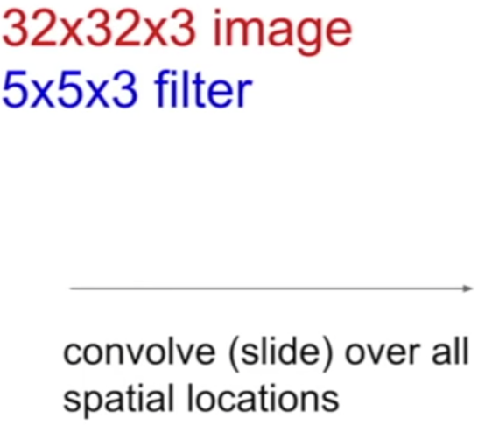
Convolution Layer
Notes:
Take the filter and start at the upper left hand corner and basically center our filter on top of every pixel in this input volume.
At every position we’re going to do this dot product and this will produce one value in our output activation map
We are just going to keep sliding it around, & at every pixel we’re going to do this operation and fill in the corresponding point in our output activation map
You can see here that the dimension are not exactly what would happen if you’re going to do this. We had 32 by 32 in the input by only 28 by 28 in the output.
We are going to go through examples of how this works out dimension wise but basically you have a choice whether you go at every pixel or whether you slide two pixels at a time. Therefor you get different size outputs depending on how many pixels you chose to slide by.

Slide 9
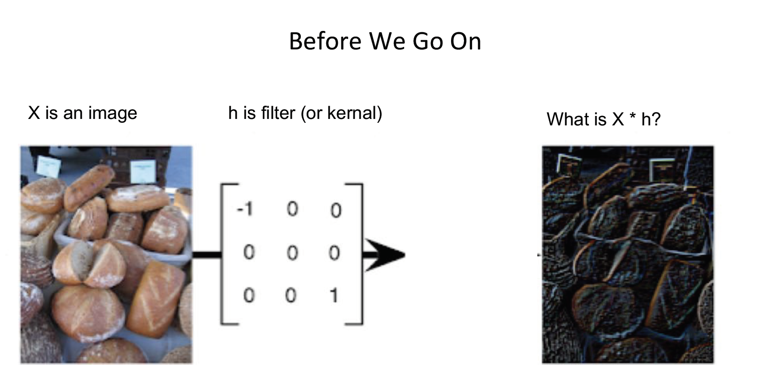
Notes:
Answer : its another image
Depending on the kernel/filter it highlights specific features.

Slide 10
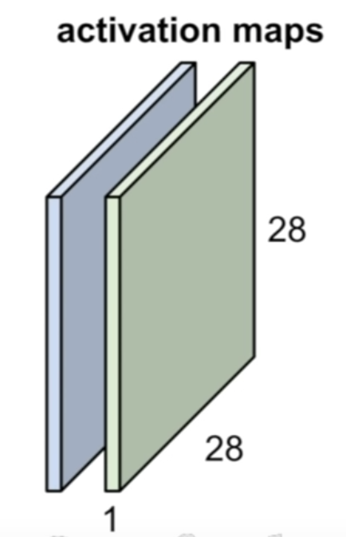
Convolution Layer
Notes:
So what we just saw is that this is taking one filter, sliding it over all of the spatial locations in the image and then we’re going to get this activation map out right, which is the value of that filter at every spatial location.
And so when we’re dealing with the convolutional layer we want to be able to work with multiple filter right because each filter is kind of looking for a specific type of template or concept in the input volume
And so we are going to have set of multiple filters. So here I’m going to take a second filter this green filter, which again 5 by 5 by three.
I’m going to slide this over all of the spatial locations in my input volume and the I’m going to get out this second green activation map also of the same size

Slide 11
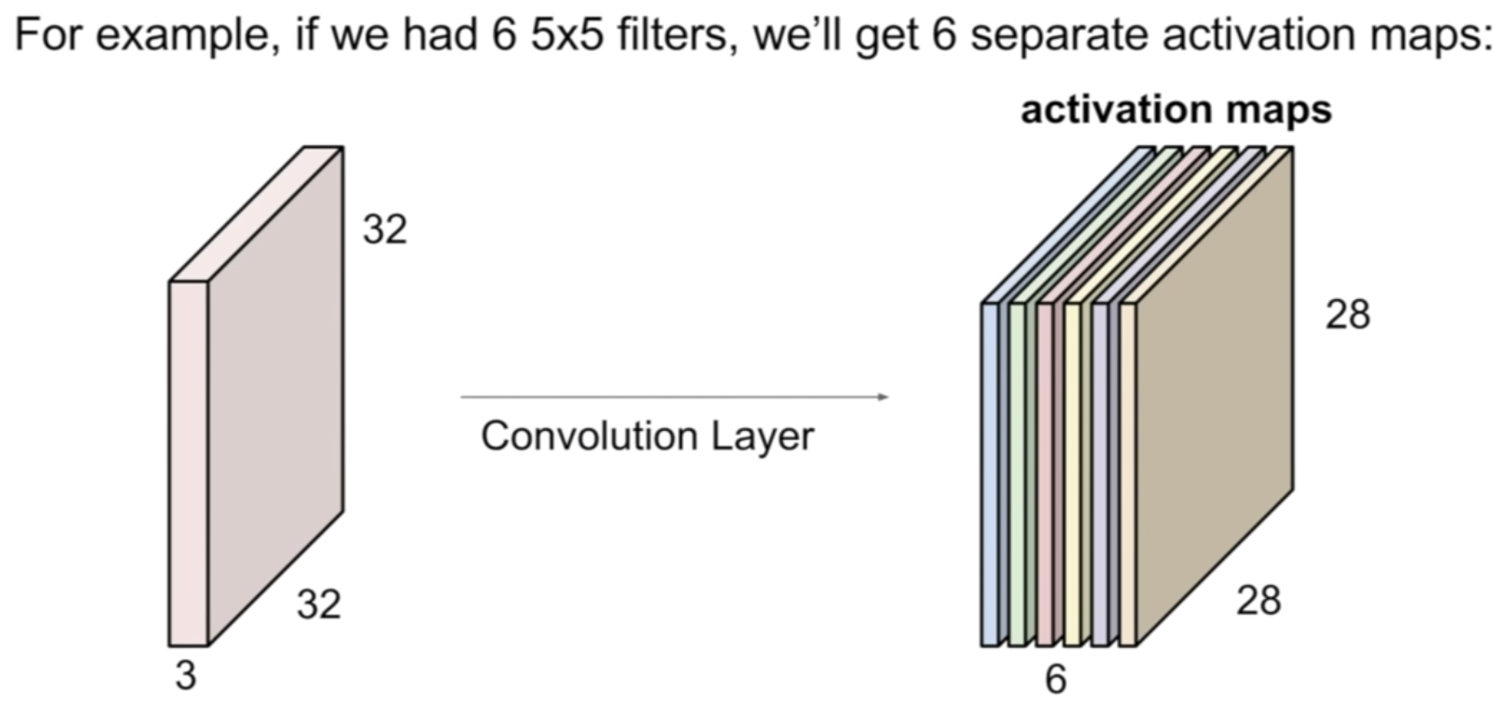
We stack them up and get a “New Image” of size 28 x 28 x 6
Notes:
We can do this for as many filters as we want to have in this layer. For example if we have 6 filters, 6 of these 5 by 5 filters then we’re going to get in total six activation maps out.
So we are going to get this output volume which is essentially our ”new image” that is going to be 6 by 28 by 28

Slide 12
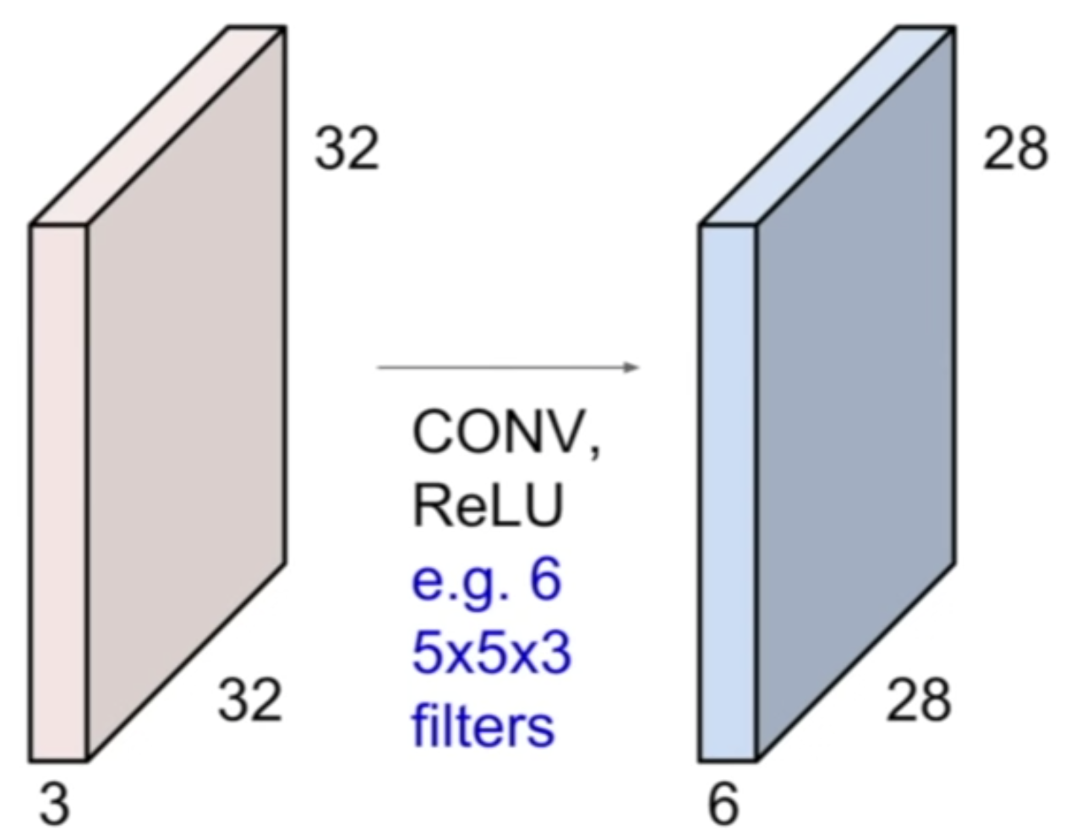
Preview: ConvNet is a sequence of Convolutional Layers, interspersed with activation functions.
Notes:
A preview of how we are going to use these convolutional layers in our convolutional network is that our ConvNet is basically going to be a sequence of these convolutional layers stacked on top of each other.
Same way as what we had with the simple linear layers in their neural network.
And then we are going to intersperse these with activation functions for example ReLU activation function.

Slide 13
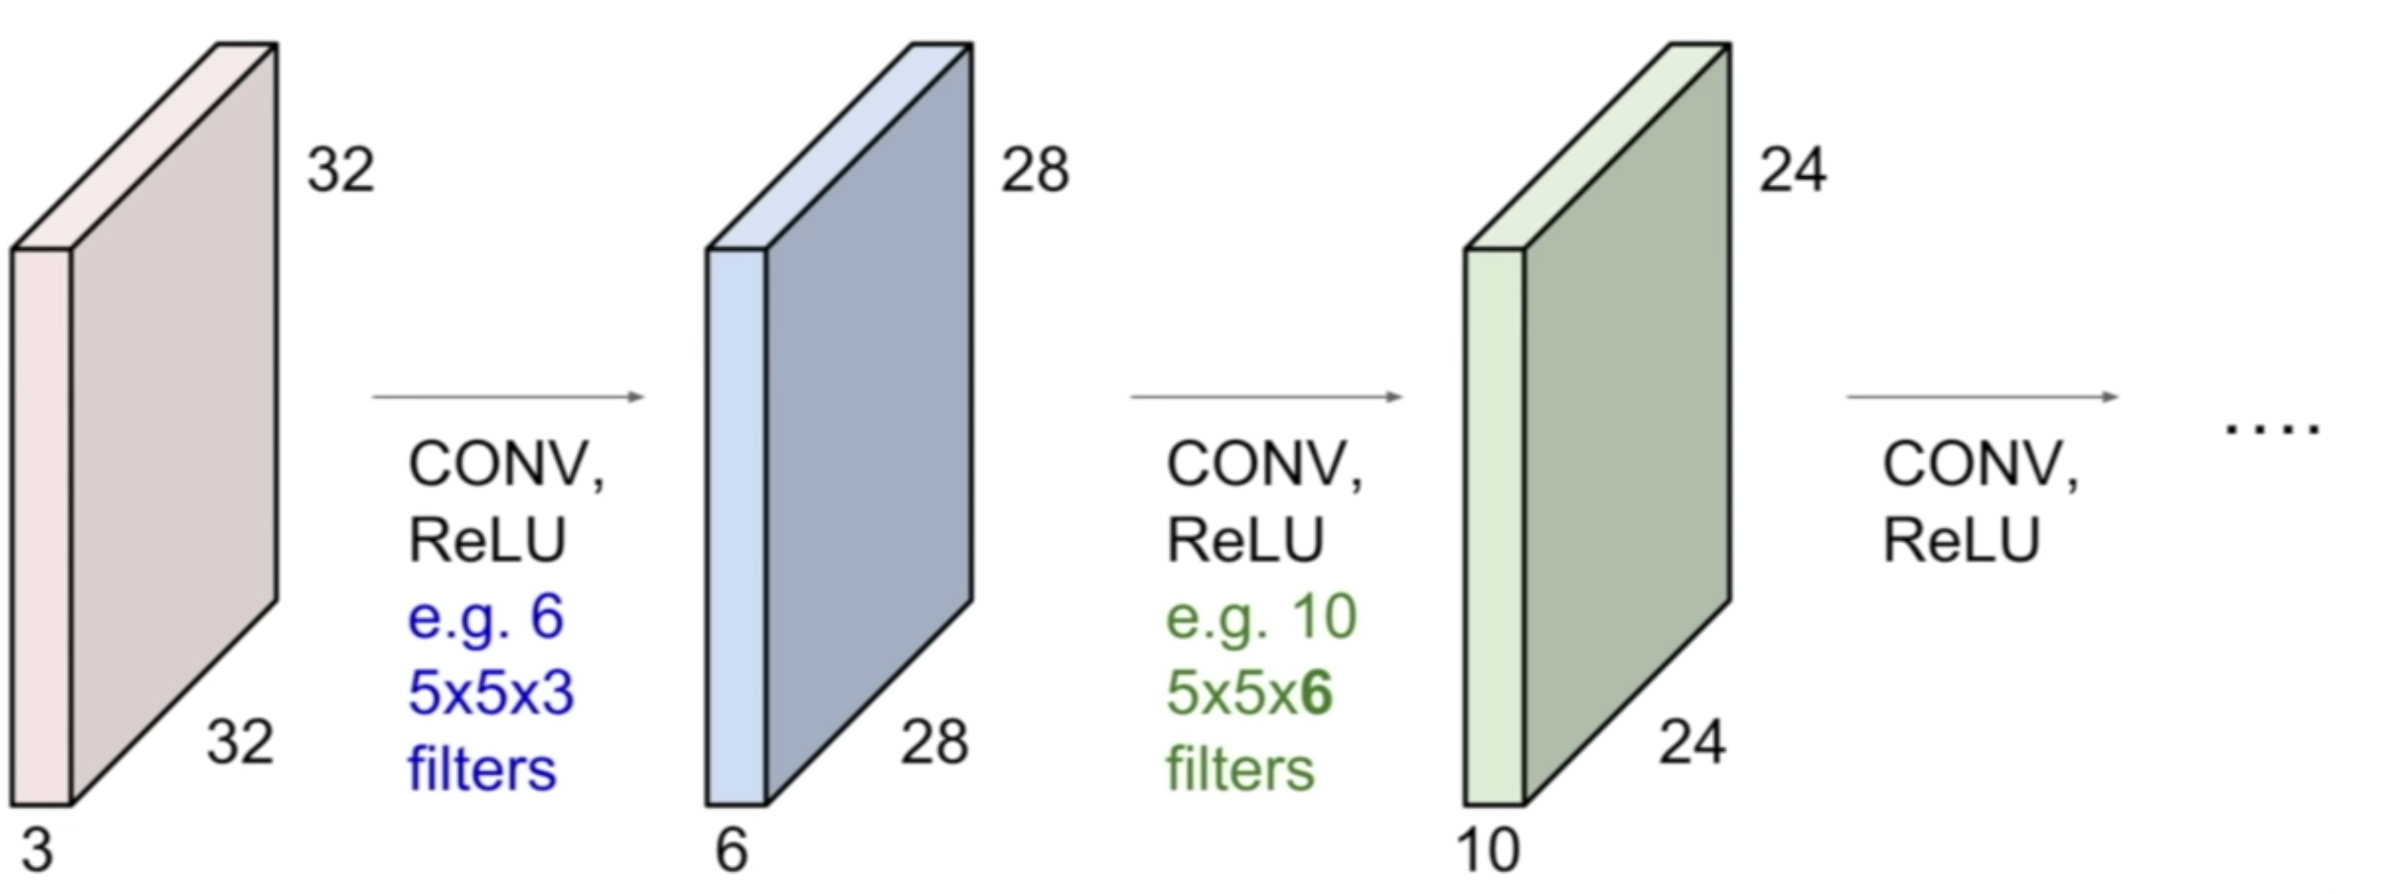
Preview: ConvNet is a sequence of Convolutional Layers, interspersed with activation functions.
Notes:
So you will get something like Conv, ReLU, usually also some pooling layers.
and then you’re just going to get a sequence of these each creating an output that’s now going to be the input to the next convolutional layer
The number of filters per layer is a design choice

Slide 14
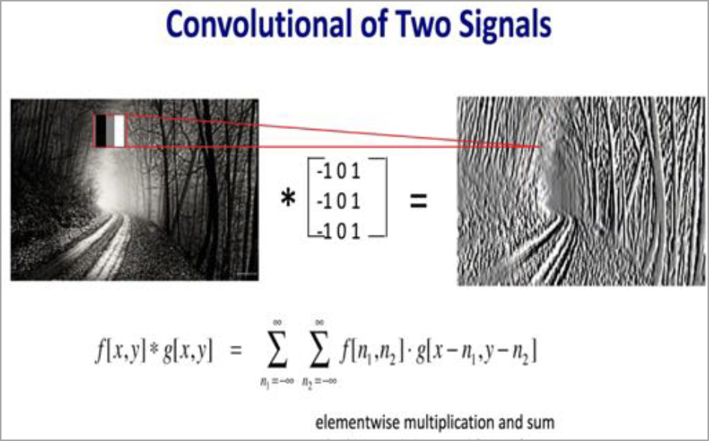
Using different types of filters affects the information extracted from an image- blur, edges, texture.
The picture represents what the Filter/Kernal was looking for
Notes:
Okay so we know each of these layers can have multiple filters right and each filter produces an activation map and so when you look at multiple of these layers stacked together in a ConvNet what ends up happening is you end up learning this hierarchy of filters
where the filters at the early layers usually represent low level features that you’re looking for, Things like edges right. And then at the mid level you’re going to get more complex kinds of features so maybe now you’re looking for things like corners and blobs .
And then at higher level features you’re going to get things that starting to more resemble concepts than blobs of.
Important to understand that what these features end up being when you have a whole stack of filters is these type of simple to more complex features.

Slide 15
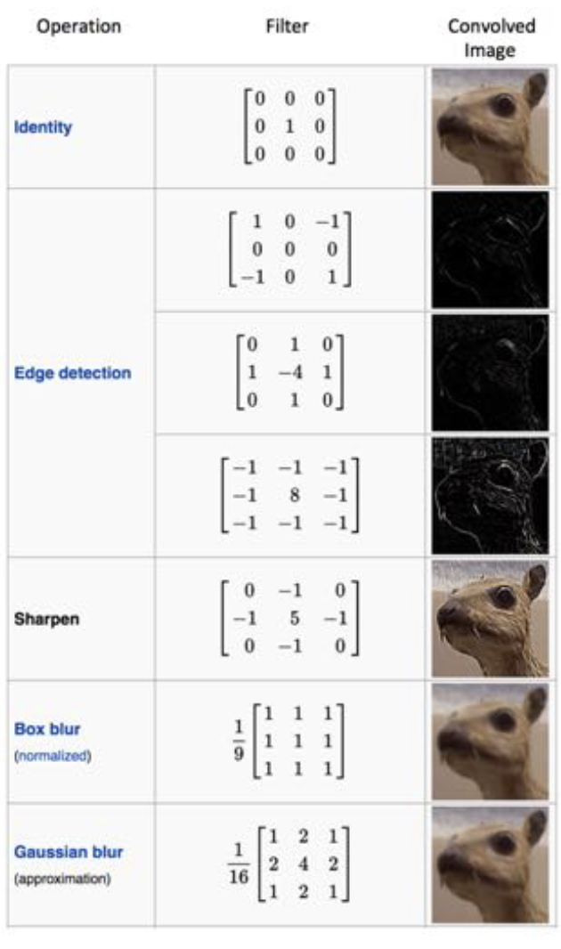
Different Filter Types
These filter are more typical for image processing,
but not feature extraction.
In CNNs, we are looking to extract features
Notes:
Where the filters at the early layers usually represent low level features that you’re looking for, Things like edges right. And then at the mid level you’re going to get more complex kinds of features so maybe now you’re looking for things like corners and blobs . And then at higher level features you’re going to get things that starting to more resemble concepts than blobs of.
Important to understand that what these features end up being when you have a whole stack of filters is these type of simple to more complex features.

Slide 16
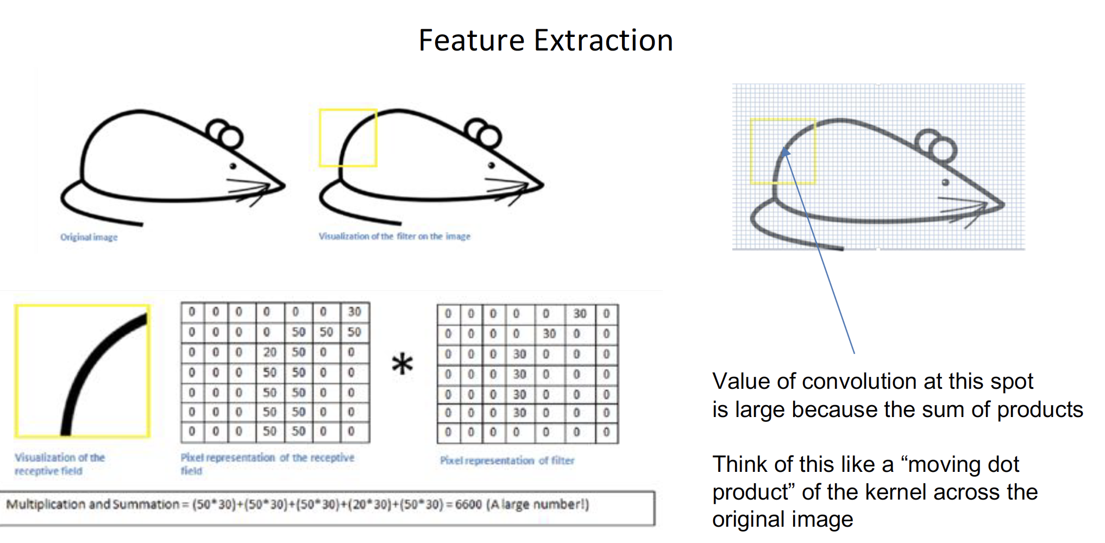
Notes:
We are looking at a local region spatially of the image and determines how much each neuron is getting triggered at every spatial location in your image

Slide 17
Spatial Dimensions:
Notes:
Lets take our 32 x 32 x 3 image from before and our 5 x5 x3 filter that we are going to slide of this image and now we are going to see exactly how we produce this 28 x 28 activation map

Slide 18
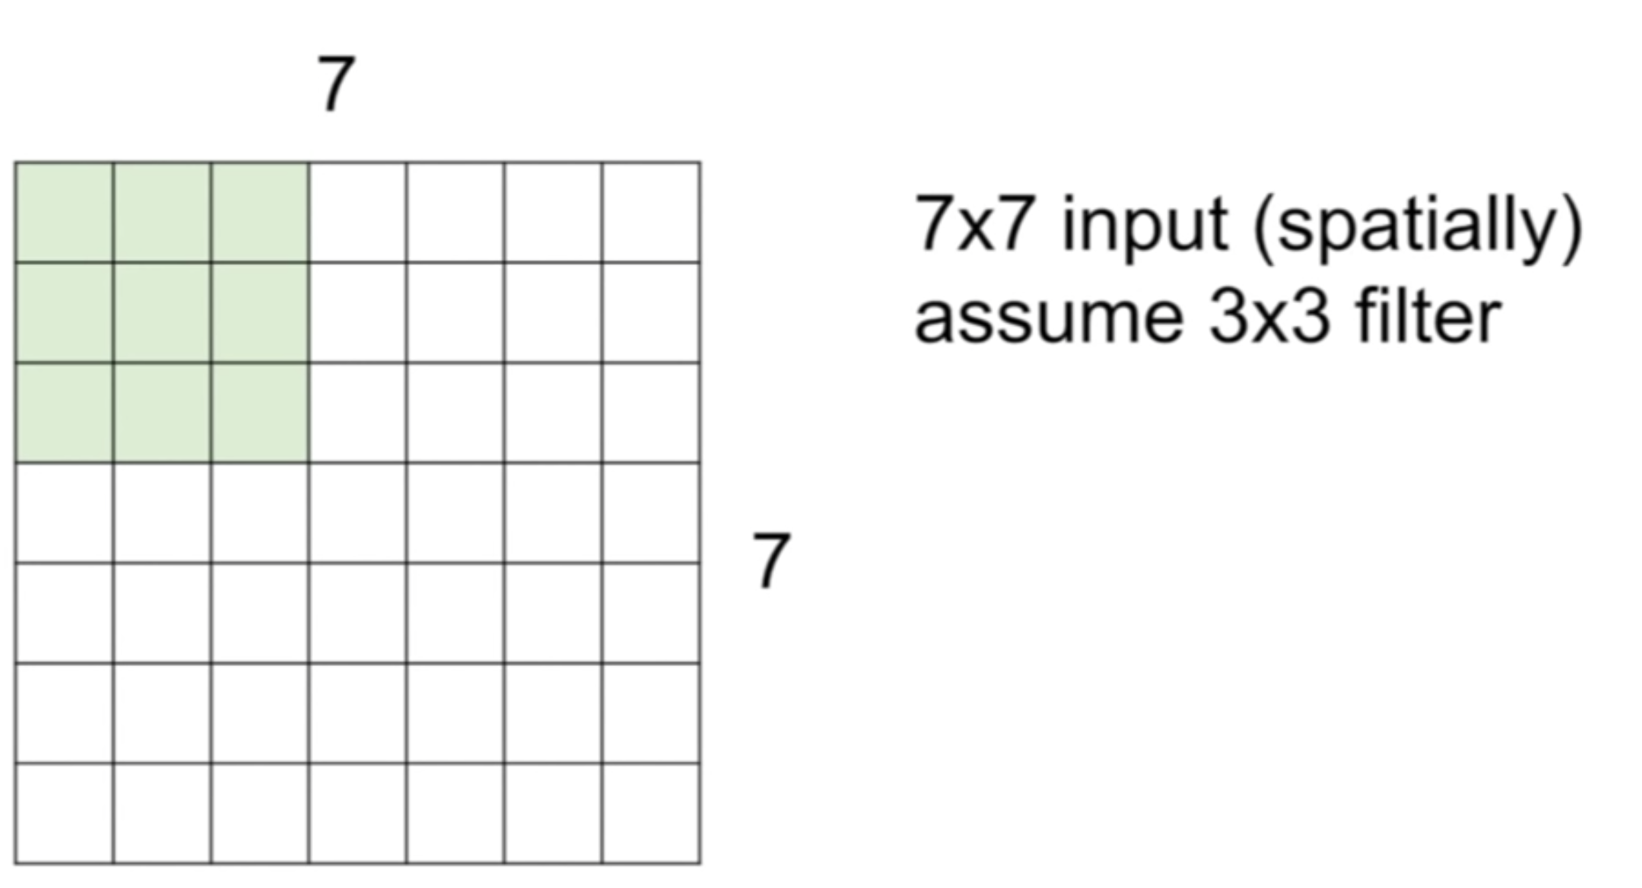
Spatial Dimensions:
Notes:
To make things simpler lets assume we have a 7 by 7 image and a 3 by 3 filter right now
We are going to take this filter plop it down in the upper left hand corner , do the dot product , so multiply all these values together to get our first value is this value is going to go into our upper left hand corner of our activation map

Slide 19
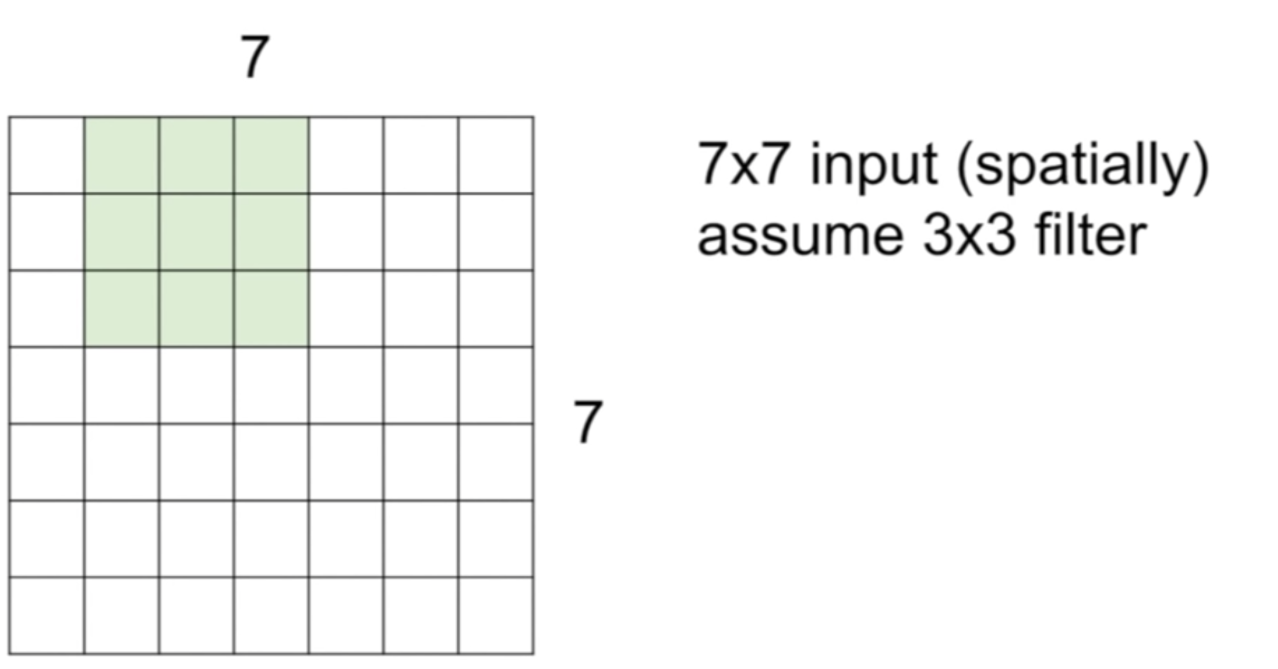
Spatial Dimensions:
Notes:
Then we are going to take this filter and slide It one position to the right and then again do the dot product and get another values out from here, and we continues with this.

Slide 20
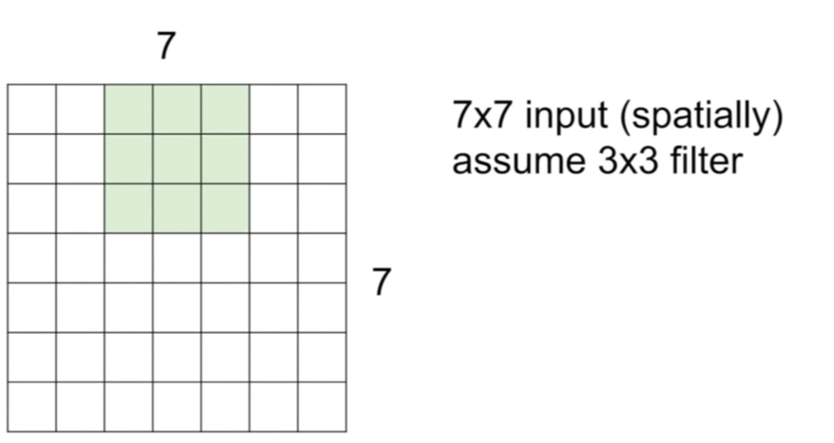
Spatial Dimensions

Slide 21
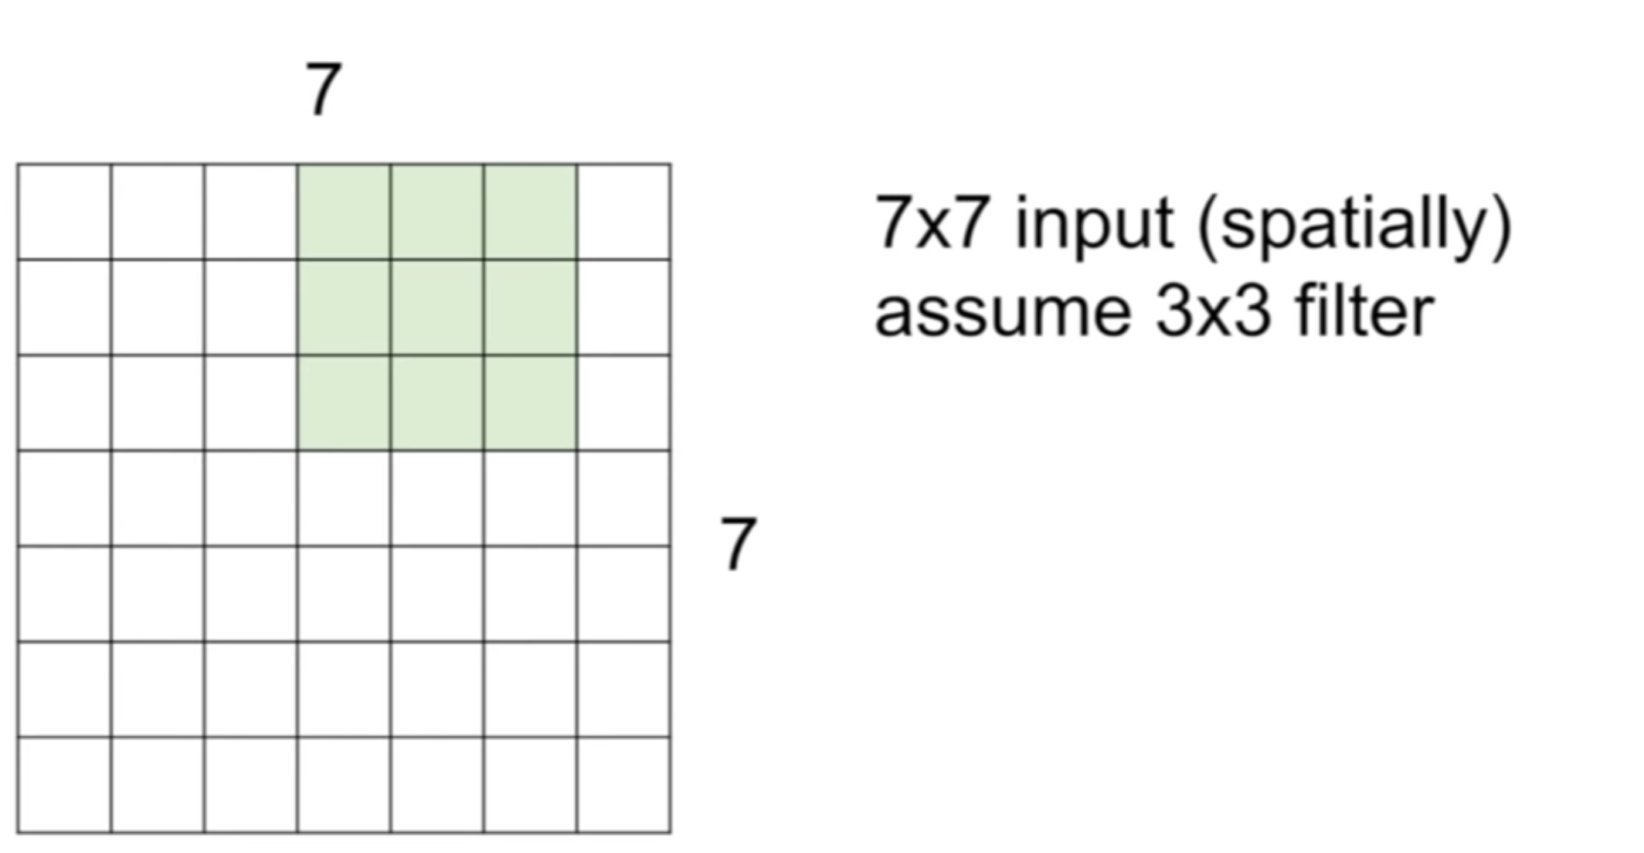
Spatial Dimensions

Slide 22
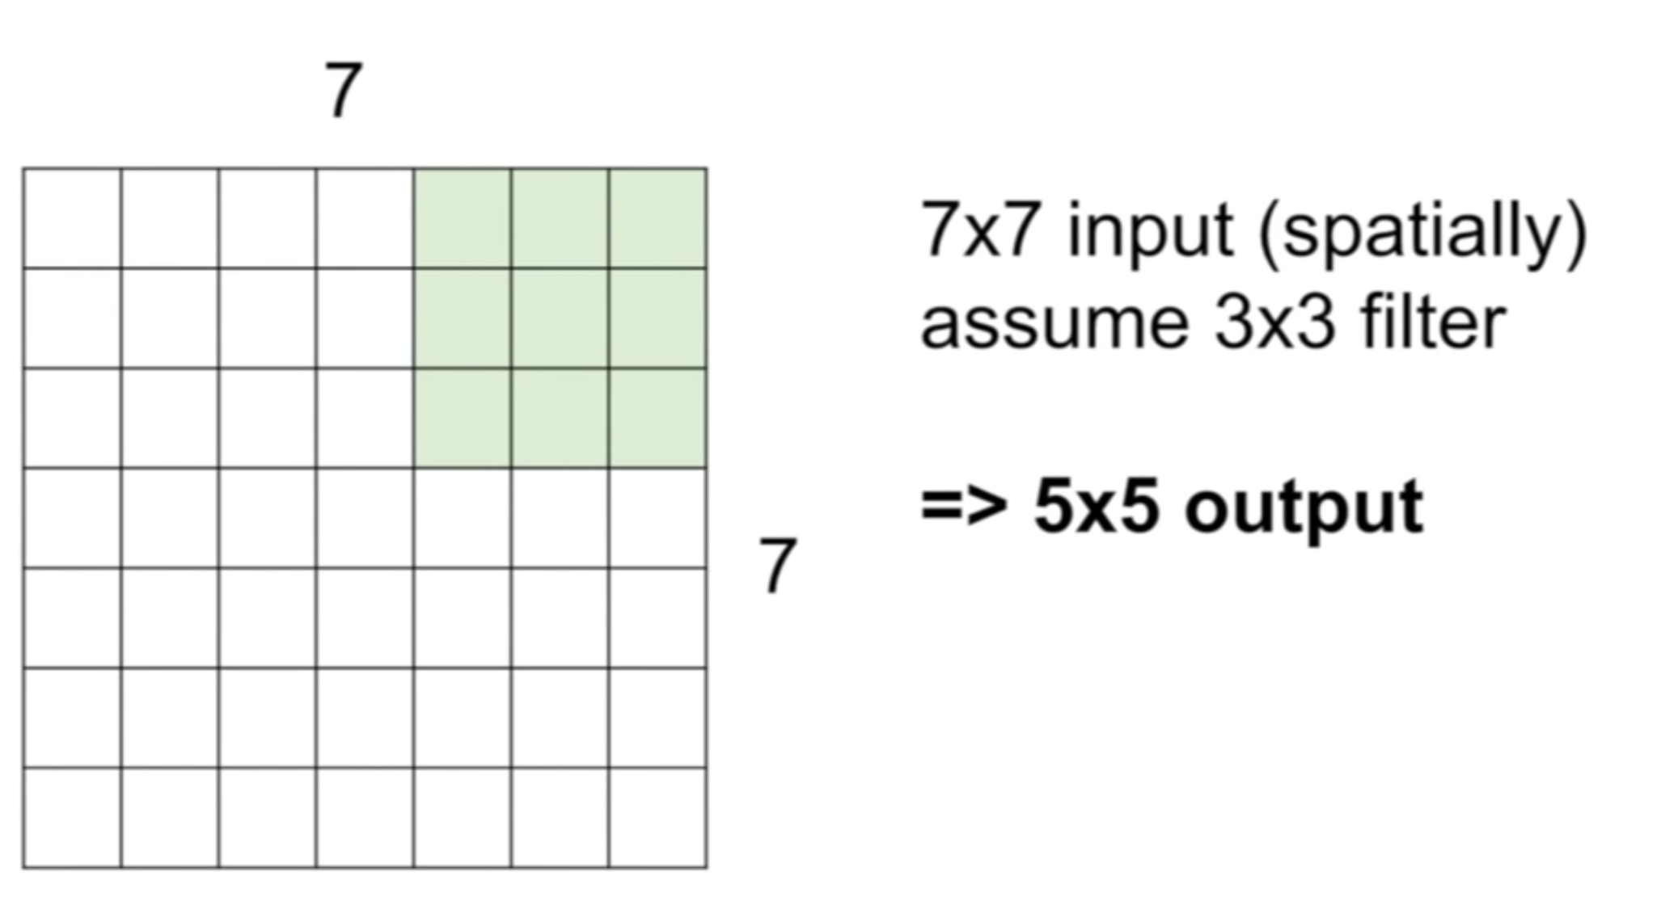
Spatial Dimensions
Notes:
In the end what we are going to get is is a 5 by 5 output right.
Because are able to slide this filter over 5 spatial locations horizontally and five spatial location vertically.
There are different design choices that we can make, previously we slid it at every single spatial location and the interval at which we slide is called the stride.
So previously we used a stride of 1
So now lets see what happens when we use a stride of 2

Slide 23
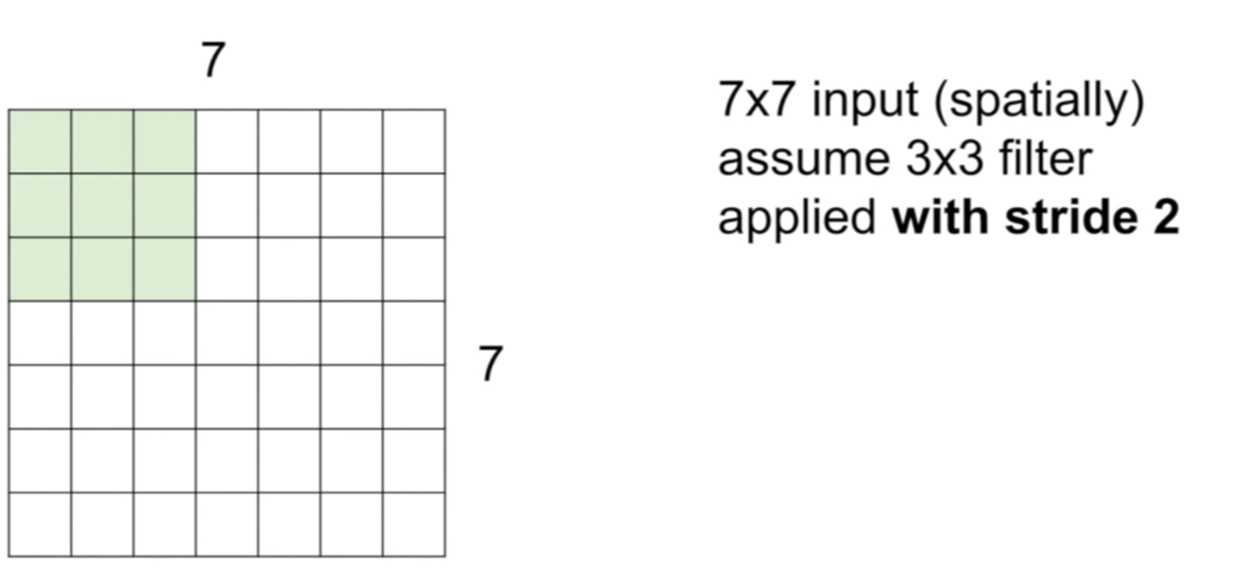
Stride 2:
Notes:
So now we are going to take our first location the same as before, and then we are going to skip this time 2 pixels over and we are going to get our next value centered as this location

Slide 24
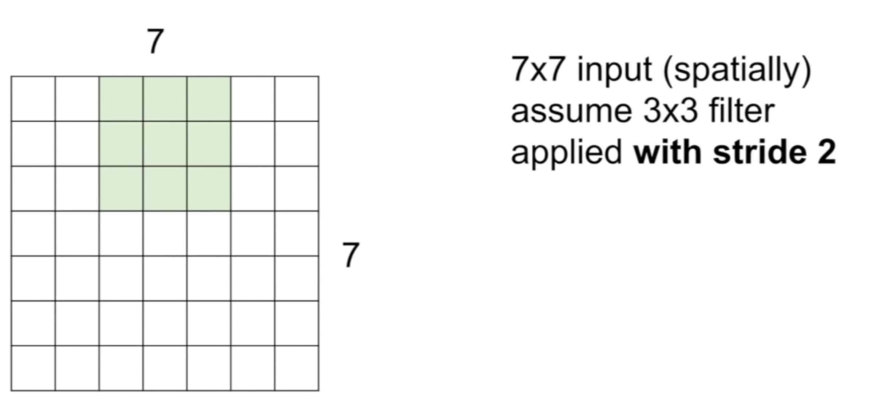
Stride 2:

Slide 25
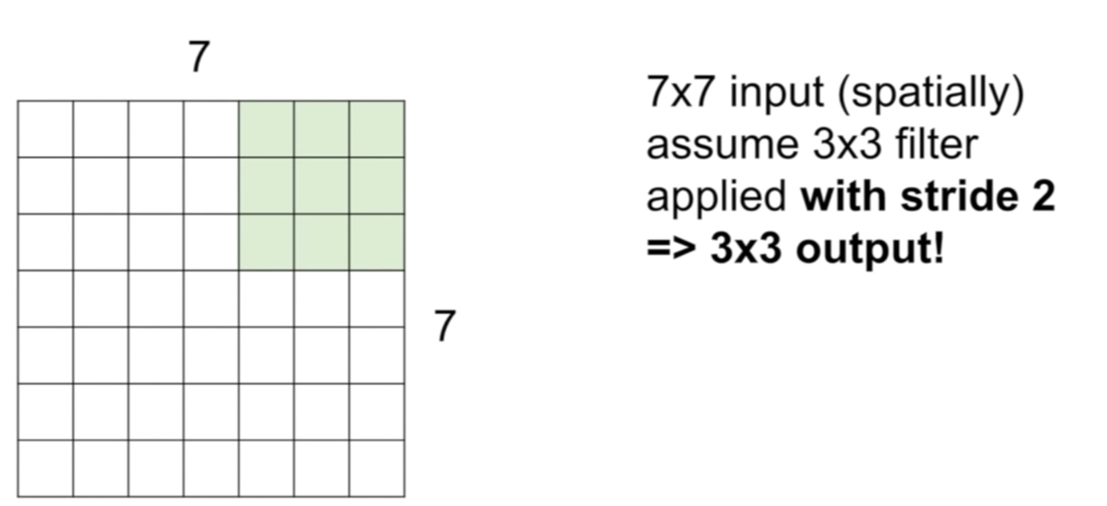
Stride 2:
Notes:
So now if we used a stride of two we have a total of three of these that we can fit and so we will get a 3 x 3 output

Slide 26
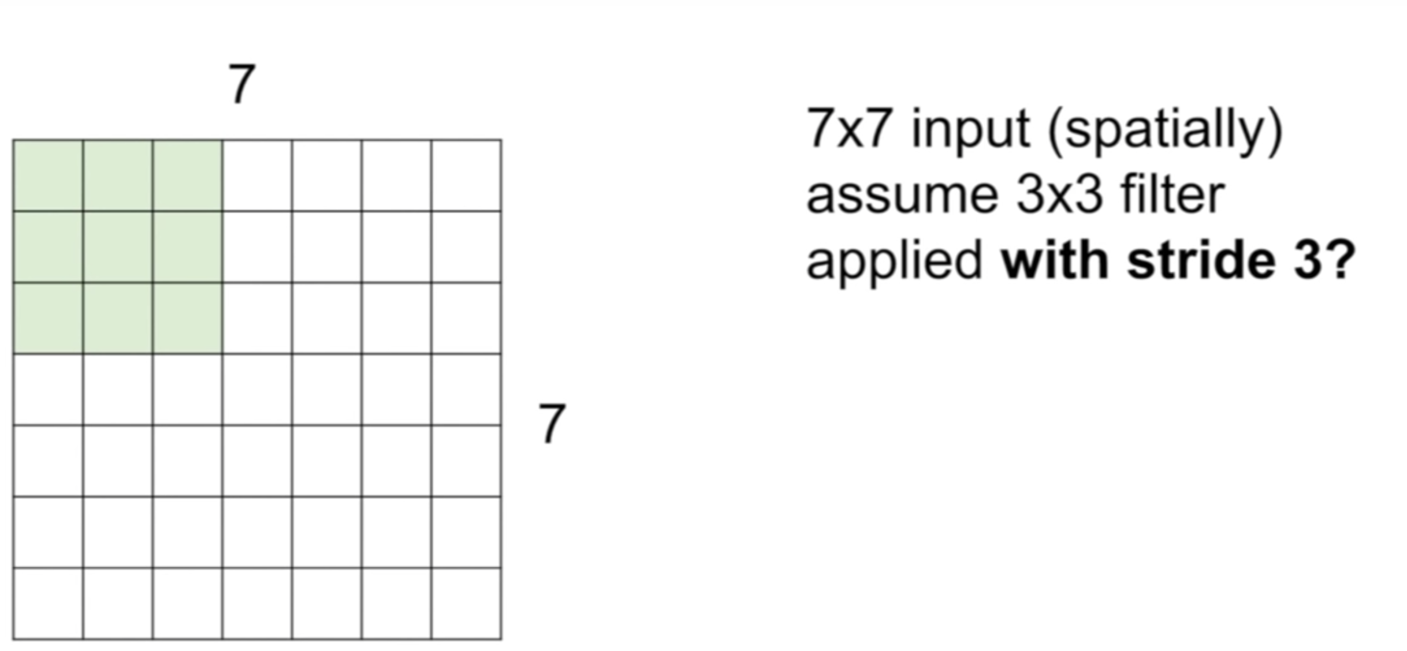
Stride 3:
Notes:
Okay so now what happens when we have a stride of three, what’s the output size of this ?
In this case we have a 3 by 3 we slide it over by 3 again

Slide 27
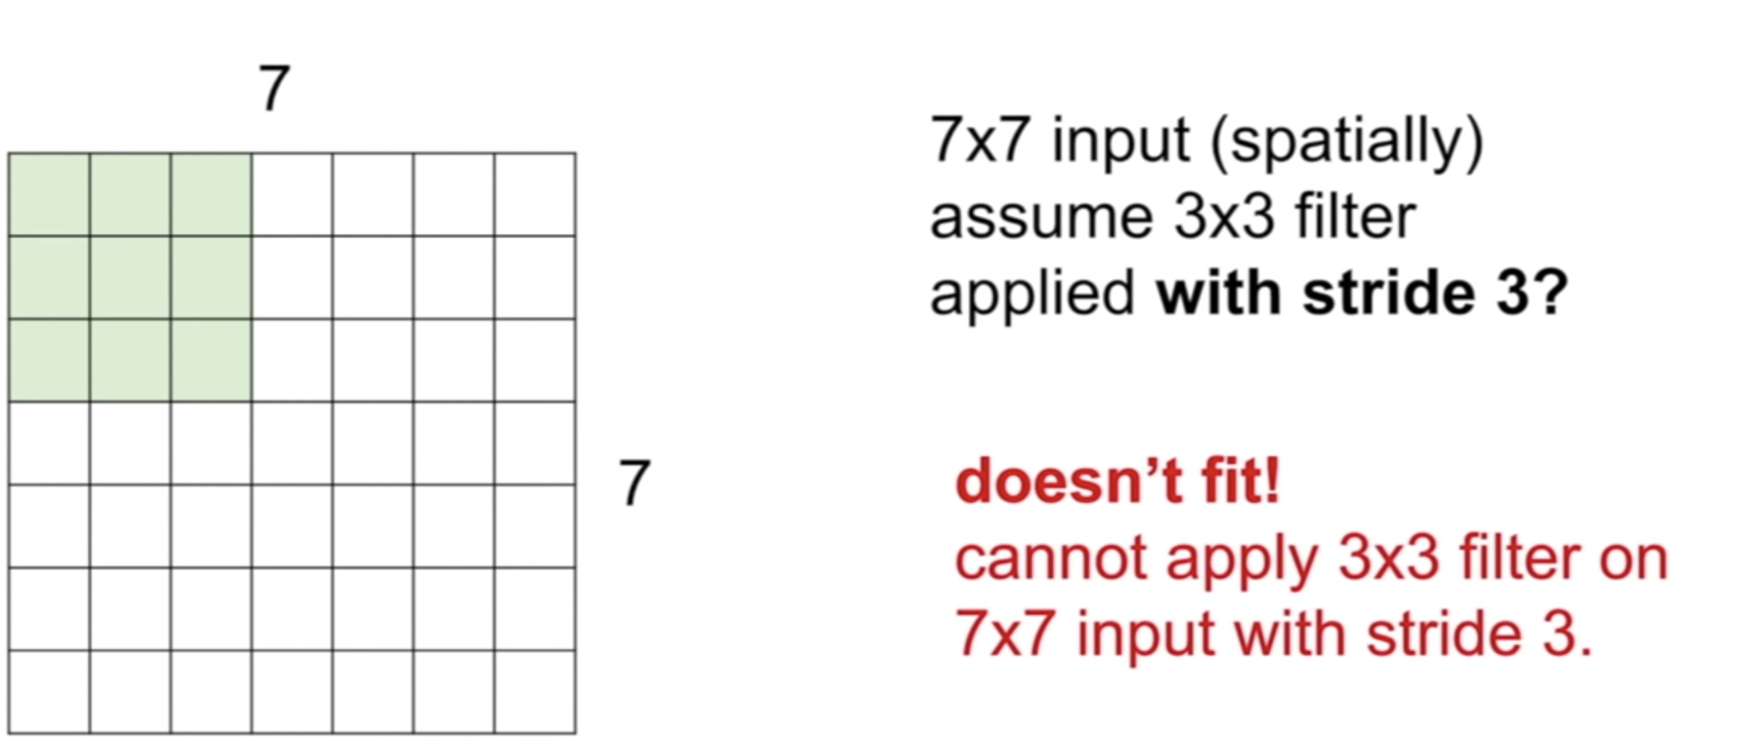
Notes:
It doesn’t’ fit , so in practice it just doesn’t work we don’t do convolutions like this because it leads to asymmetric output happening

Slide 28
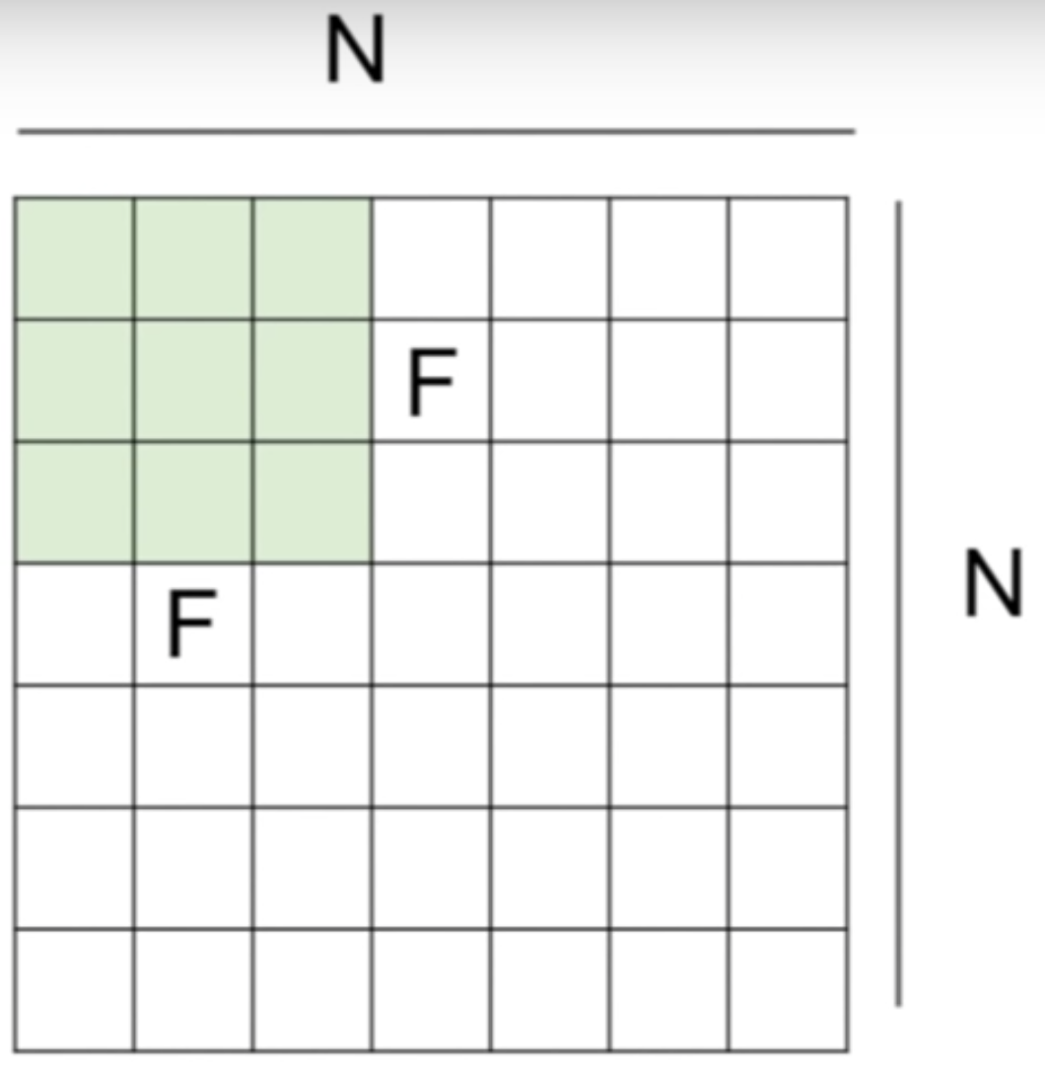
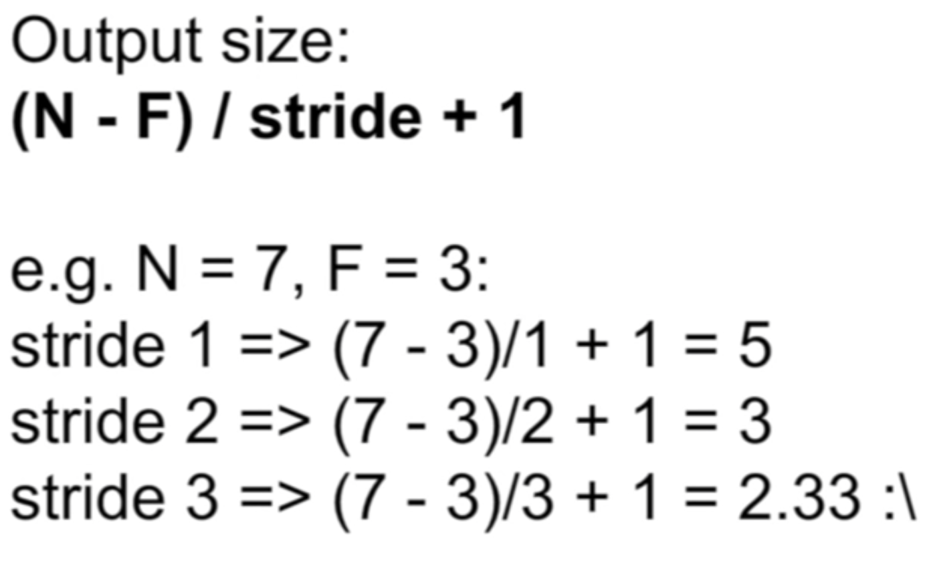
Calculating output size:
Notes:
So lets see how we can computer output size.
This actually works out to be a nice formula where we take our dimension of our input N, we have a filter size F, we have our stride at which we are sliding along and our final output size.
The spatial dimension of each output size is going to be N – F / stride +1

Slide 29
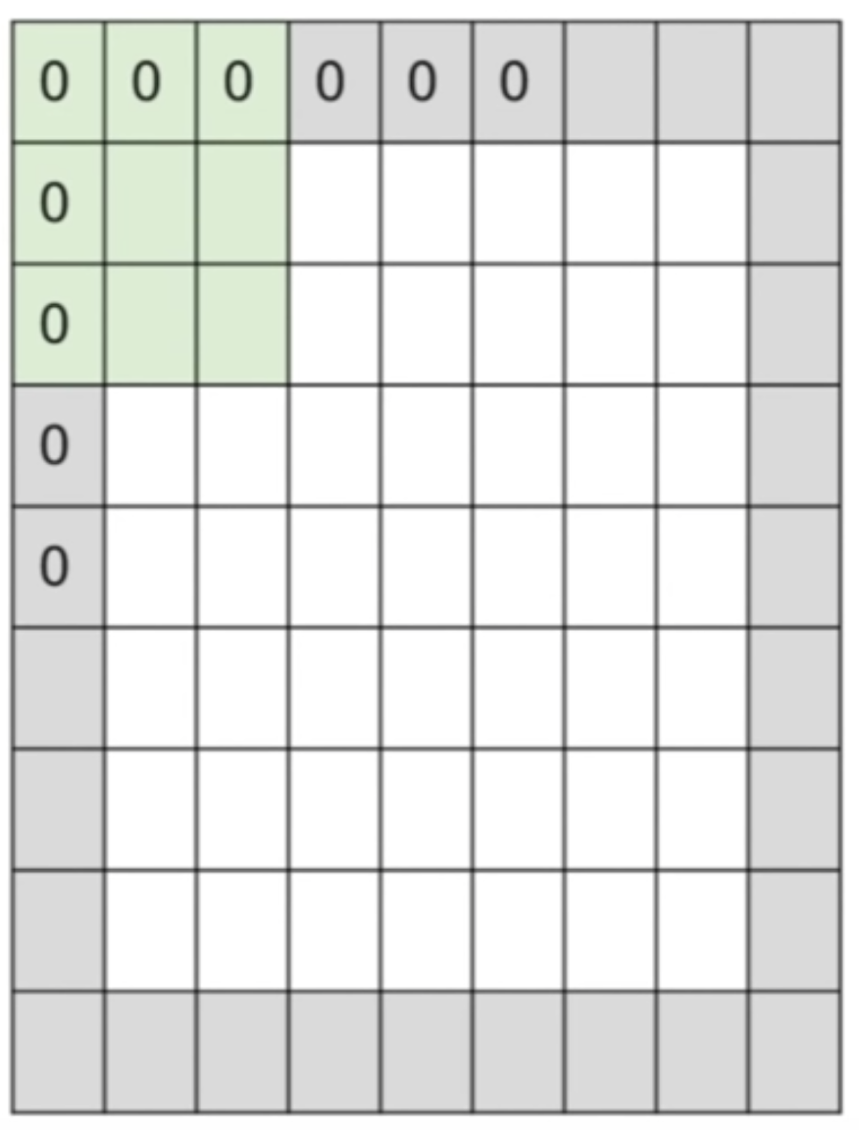
In practice: Common to zero pad the border
Notes:
In practice its actually common to zero pad the borders in order to maintain the same input size as we had before, or just a specific size that you may want the output to have
We pad our input image with zeros and so now we can place a filter centered at the upper right hand pixel location of your actual input image.
Zero padding helps us process the edges/corners of the image and so padding is a way to do this.

Slide 30
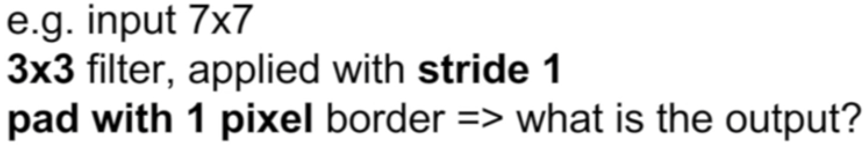
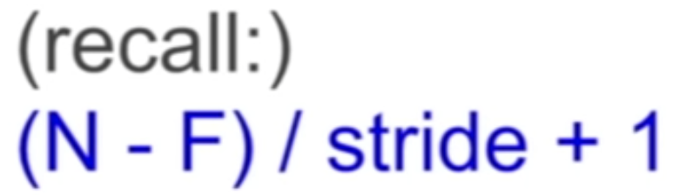
In practice: Common to zero pad the border
Notes:
Although our input is 7 x 7 we actually increase the dimension to 9 x 9 by padding the image. So we want to incorporate this padding into the formula. so now our N = 9 our F –s still equal to 3 and stride is still 1.
((9-3)/1) +1 = (6/1) +1 = 7
But remember the total output size of that layer would be 7 x 7 x ( # of filters that you have)
Remember each filter is going to do a dot product through the entire depth of your input volume and that’s going to produce one number
Each filter is producing 1 x 7x7

Slide 31
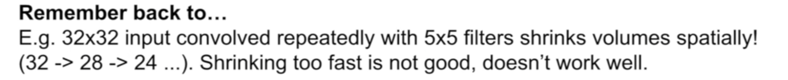
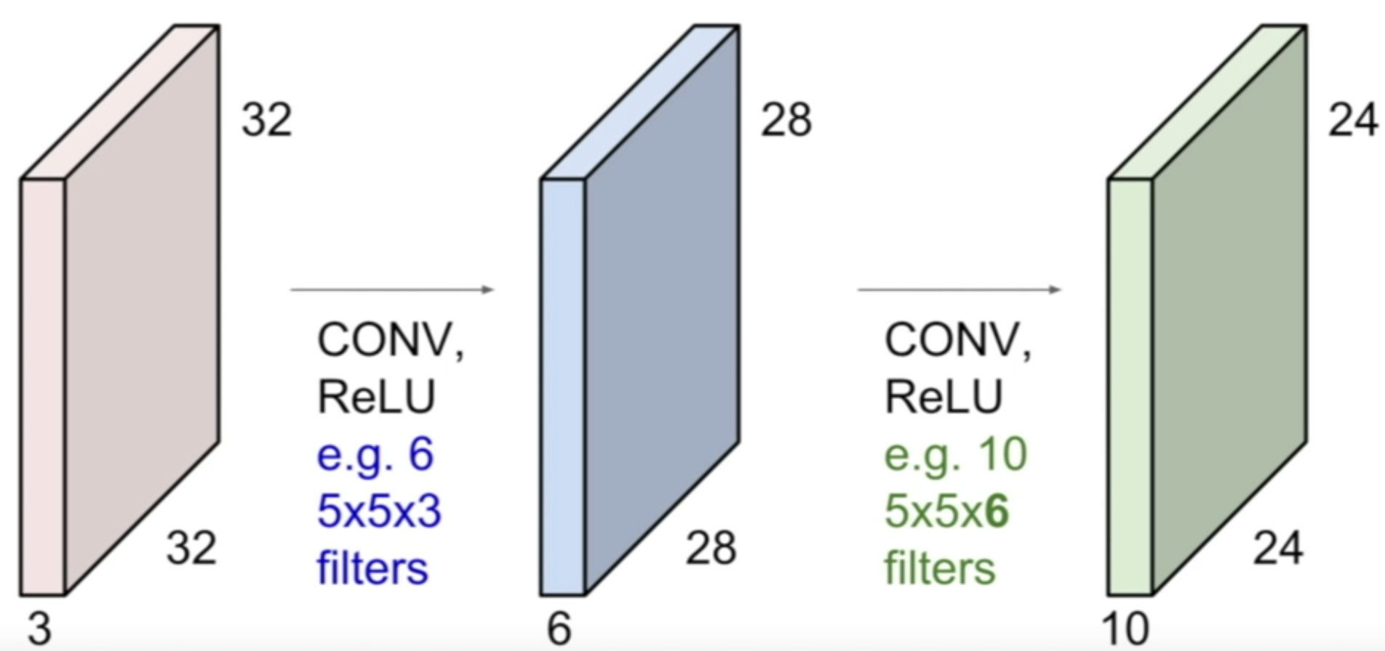
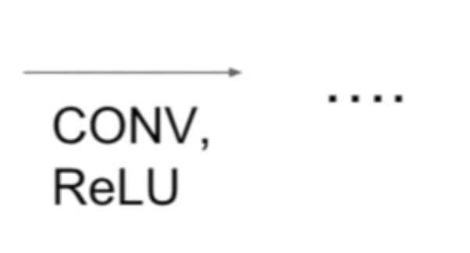
Notes:
If you have multiple of these layers stacked together you’ll see that , if we don’t pad we going to really quickly shrink the size of the outputs we have.
And this is not something we want because it is kind of like throwing away data points.
You can imagine if you have a pretty deep network then very quickly the size of your activation maps is going to shrink to something very small.
This is bad both because we’re kind of losing out on some of this information & now you’re using a much smaller number of values in order to represent your original image.

Slide 32
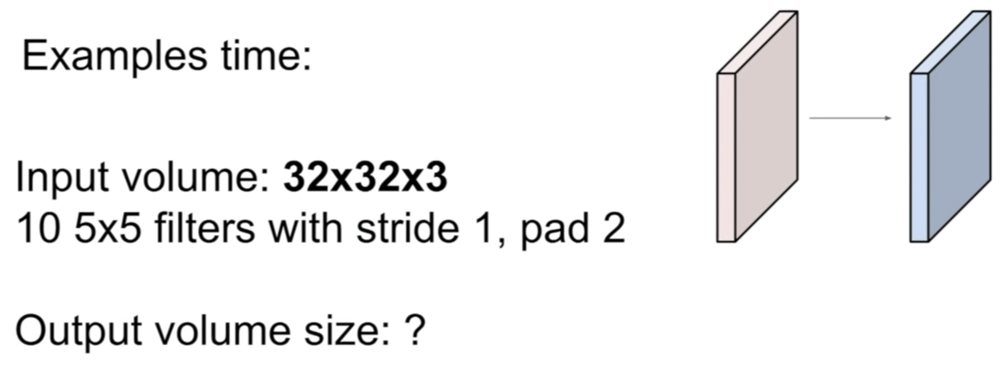
Notes:
32 x 32 x10
N – F / stride +1
N = 36
F = 5
Stride = 1
(36-5)/1 +1 = 31/1 +1 = 32
Therefore we have 32 *32 *10

Slide 33
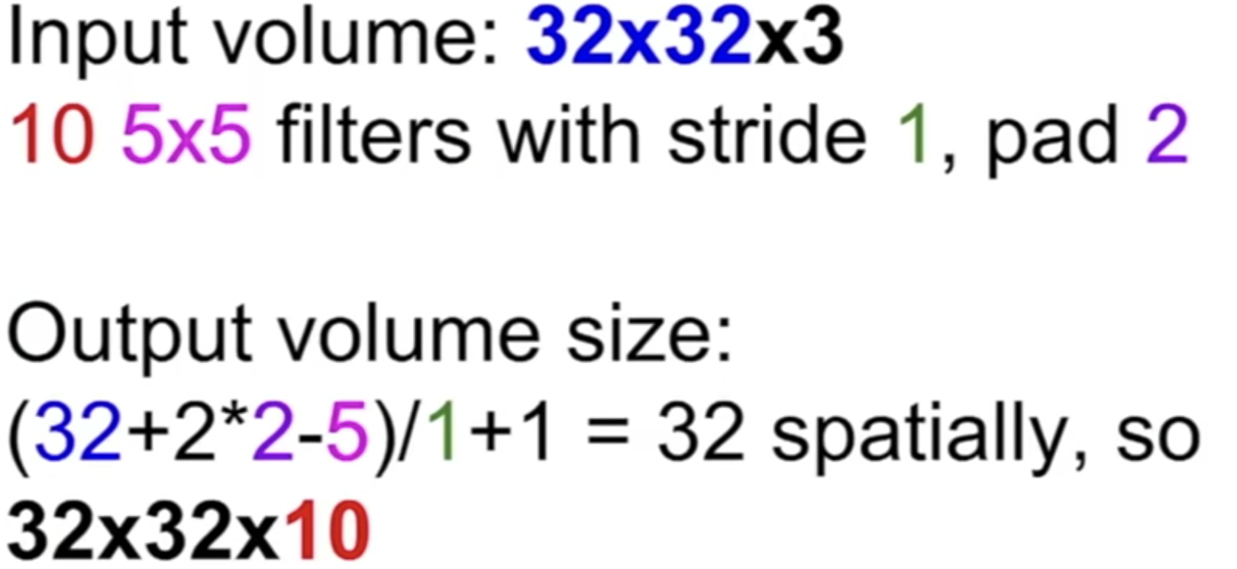
Notes:
32 x 32 x10
N – F / stride +1
N = 32 + (2*2) = 26
F = 5
Stride = 1
(36-5)/1 +1 = 31/1 +1 = 32
Therefore we have 32 *32 *10

Slide 34
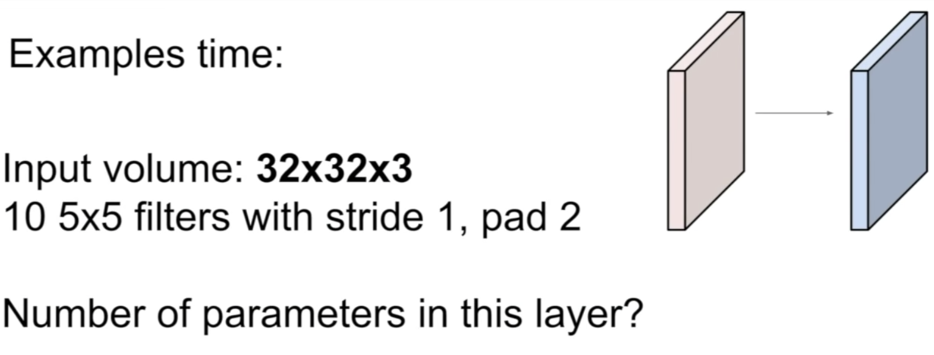
Notes:
Although the filters are 5 x 5 remember that the depth always matches that of the image. So the filter is actually 5 x 5 x 3

Slide 35
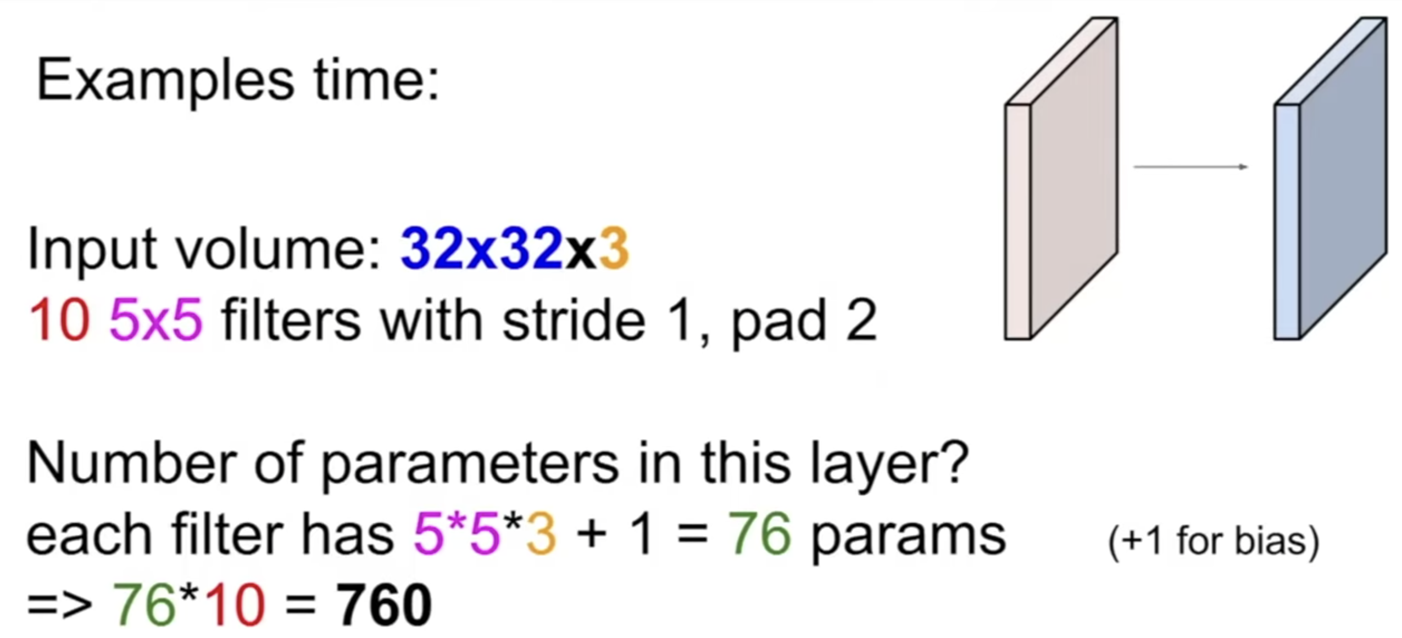

Slide 36
Hyperparameters
Hyperparameters can be tuned to change complexity and size of extracted features
Filter Size, Stride (step size of the filter), Zero-padding (to maintain dimensions)
Notes:
Stride is kind of like the resolution at which you slide the filter at. When we have a larger stride we get a down sampled image
And so what this down sampled image lets us have is both , it’s kind of like pooling in a sense cause you get the same affect of down sampling your image. But it also affect the total number of parameters
Trade off , between the number of parameters/ size of your model/ overfitting

Slide 37
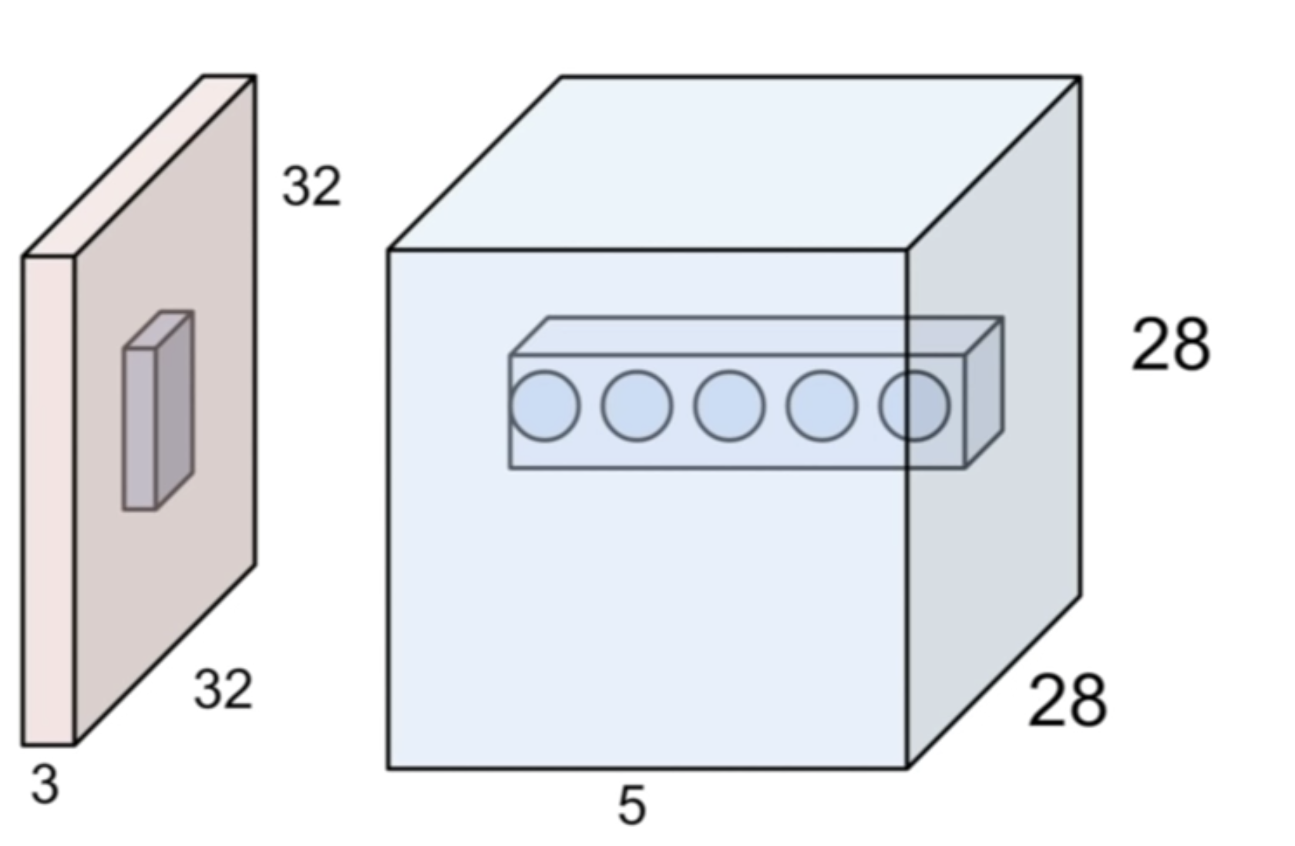
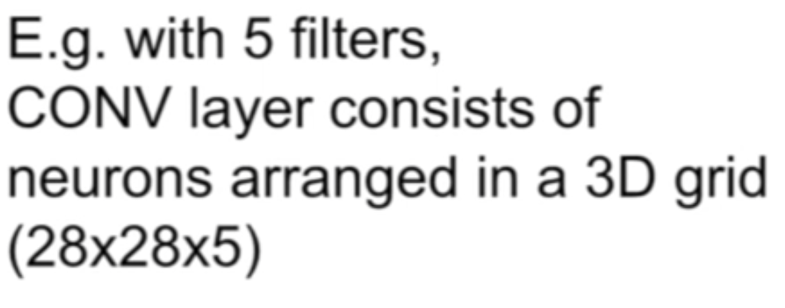
Neuron View of the CONV Layer
Notes:
So with 5 filters we are going to get this 3d 28 x 28 x 5 grid .
If you look at the filters across in on spatial location of the activation grid, going through the depth of these 5 neurons, all of these neurons are looking at the same region in the input image but they are just looking for different things/ because each neuron comes from a different filter applied to the same spatial location in your image.

Slide 38
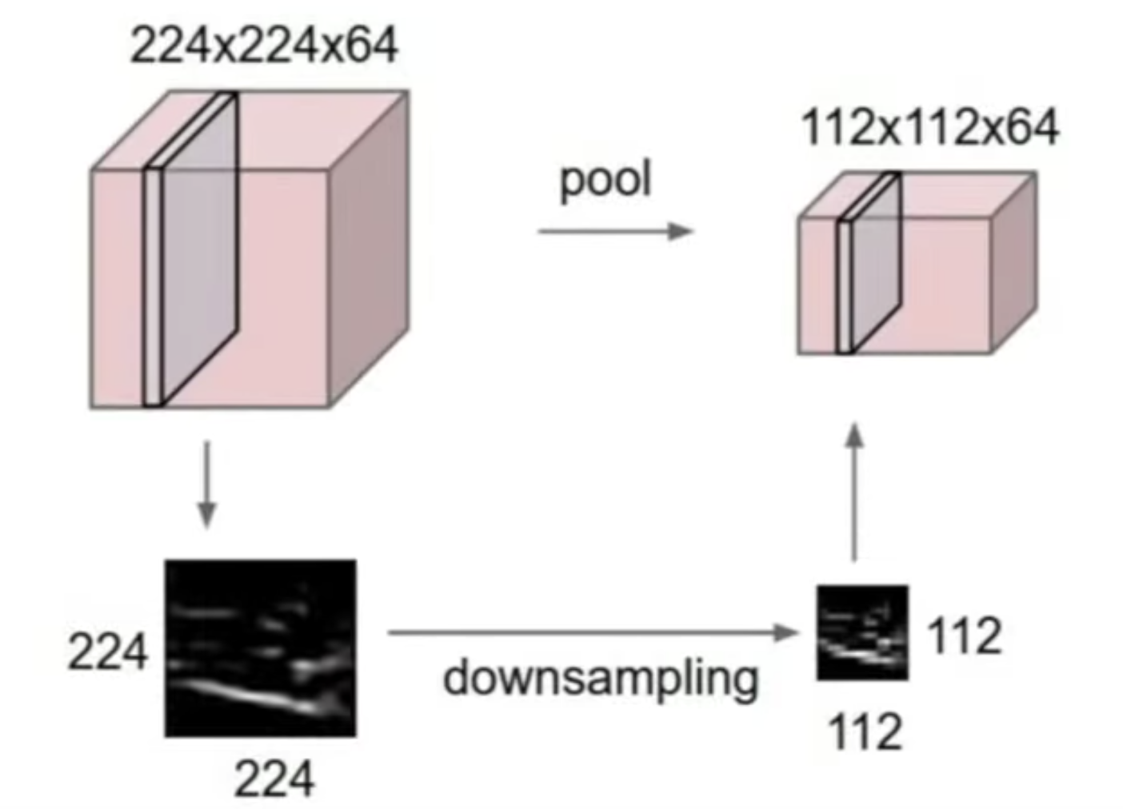
Pooling Layer
- Makes the representations smaller and more manageable
- Operates over each activation map independently
Notes:
Affects the number of parameters that you have at the end, affectively just down samples
But remember this does nothing to the depth , we are only pooling spatially

Slide 39
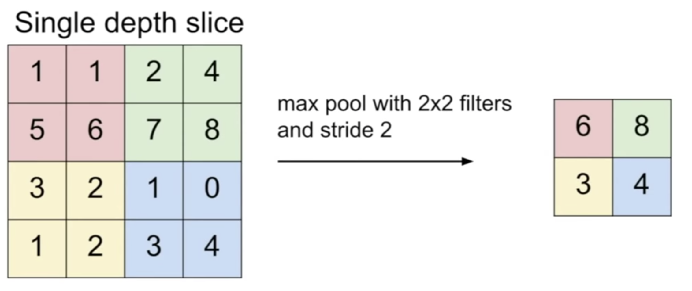
Max Pooling
Notes:
We are going to again slide it with a stride of 2 but now instead of doing dot products we are just going to get the max value
Typical to not have overlap so pick a stride value that allows for no overlap
We want to down sample so we want to look at a given region and just get one value then move on to the next region
Why max pooling < these are activations of my neurons , so each value is kind of how much this neuron fired at the location , so max pooling gives a signal of how much this filter fired at any location in the image. And if we are trying to to detect and image recognition it is more intuitive to select area that most fired because that is the part of the image that filter was looking for

Slide 40
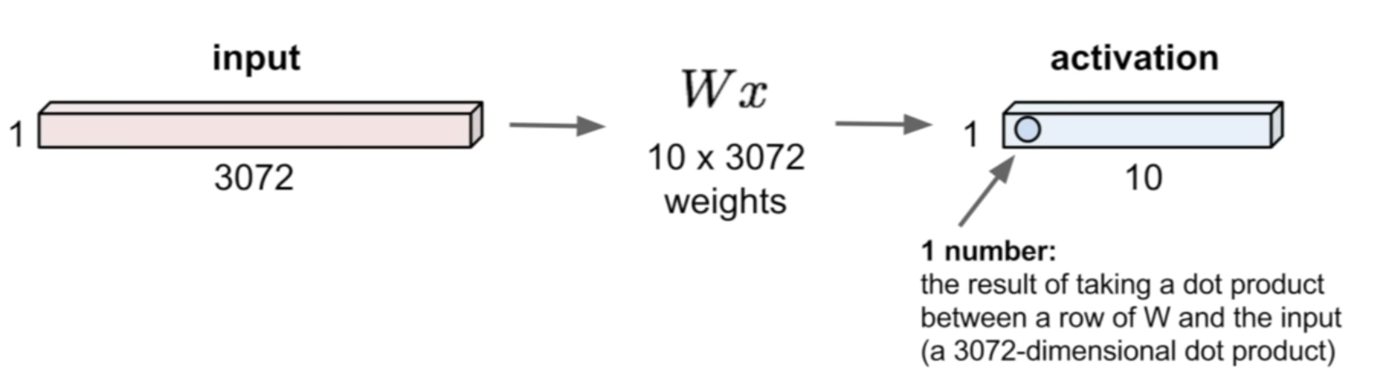
Fully Connected Layer
32 x 32 x 3 image => stretch 3072 x 1
Notes:
In a fully connected layer we stretch the input and the multiply by weight matrix

Slide 41
Notes:
Pooling down samples size of our activation maps
Take our last conv output then use a fully connected layer connected to all of these conv outputs and use that to get a final score func

